Slide 1
Project Update 4/5
Josh Howard

Slide 2
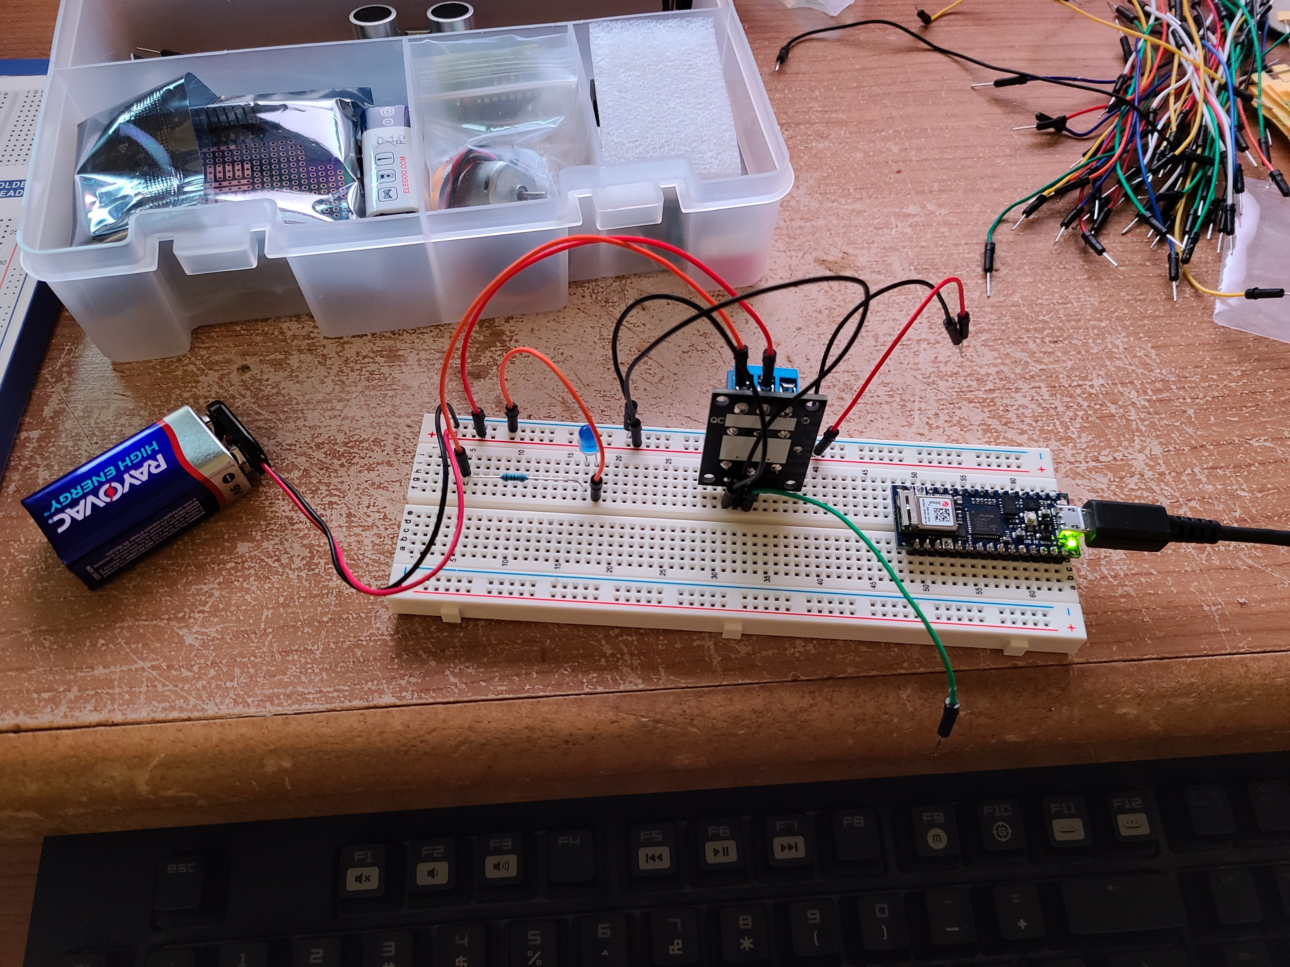
External Power!
As I intend to set this up to control a wall outlet, I decided to go ahead and set up external power. Doing this did require a rework of the circuit.
Although the USB cord is plugged into the nano, this is just for programming. The 9V battery on the left powers the LED controlled by the relay, the relay itself and the nano once running.

Slide 3
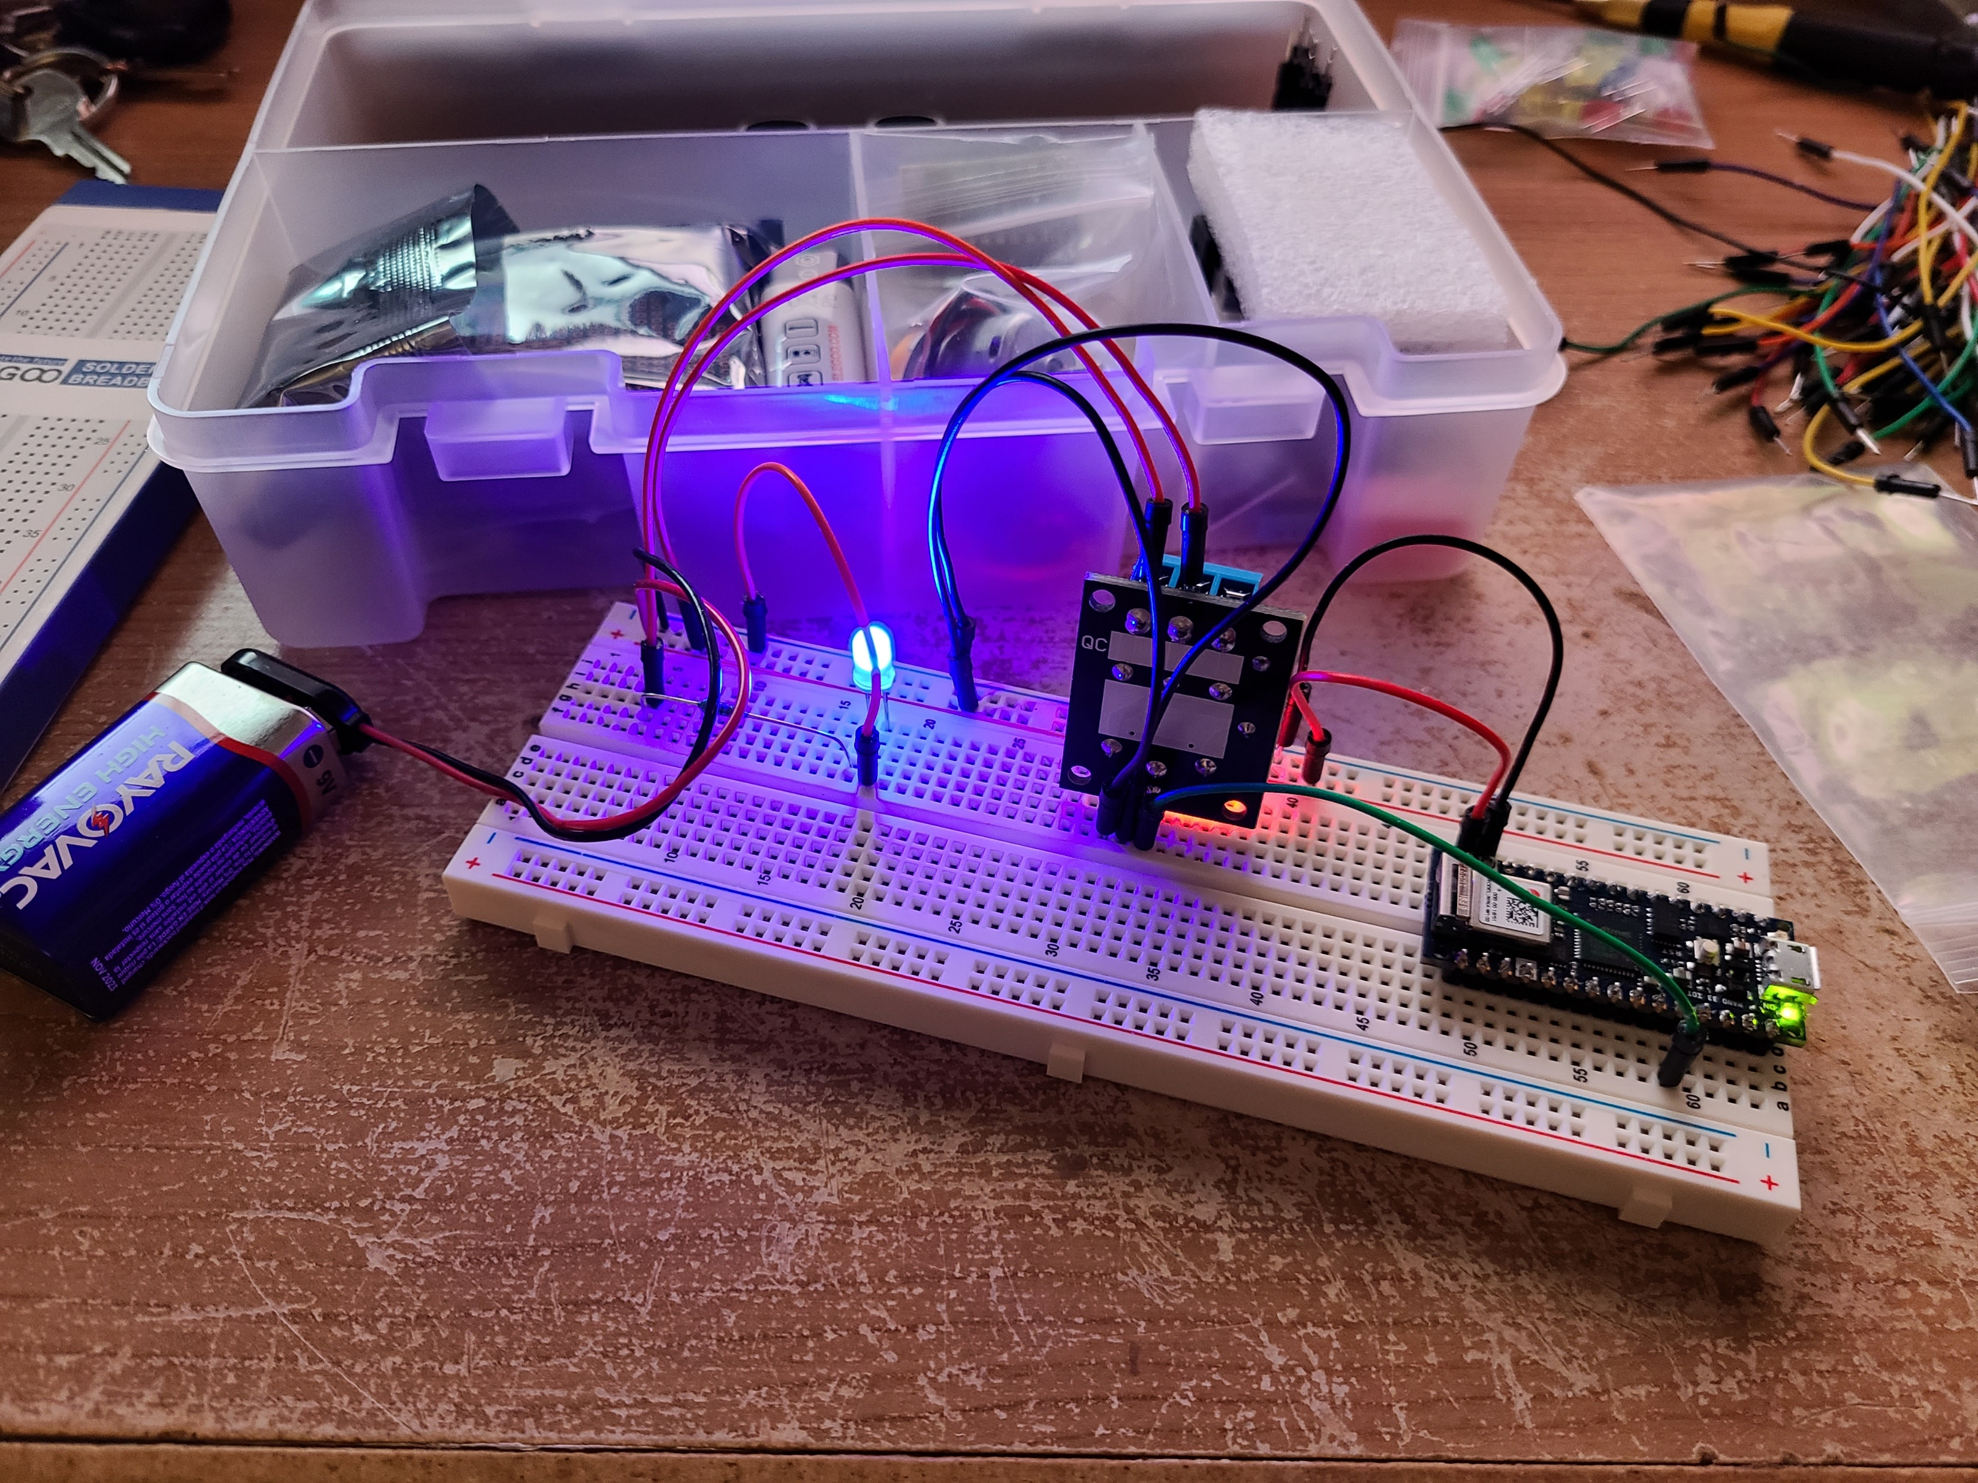
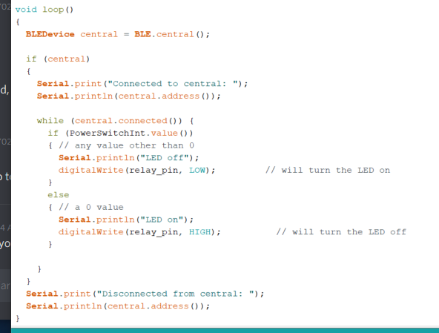
Controling the Relay
Here I got the function/loop for turning the LED on and off set. Whenever the BLE characteristic is set to 0, the LED is on. When it is set to anything else the LED is off. This is done by setting the relay to either HIGH or LOW. Though this is where I started having problems…

Slide 4
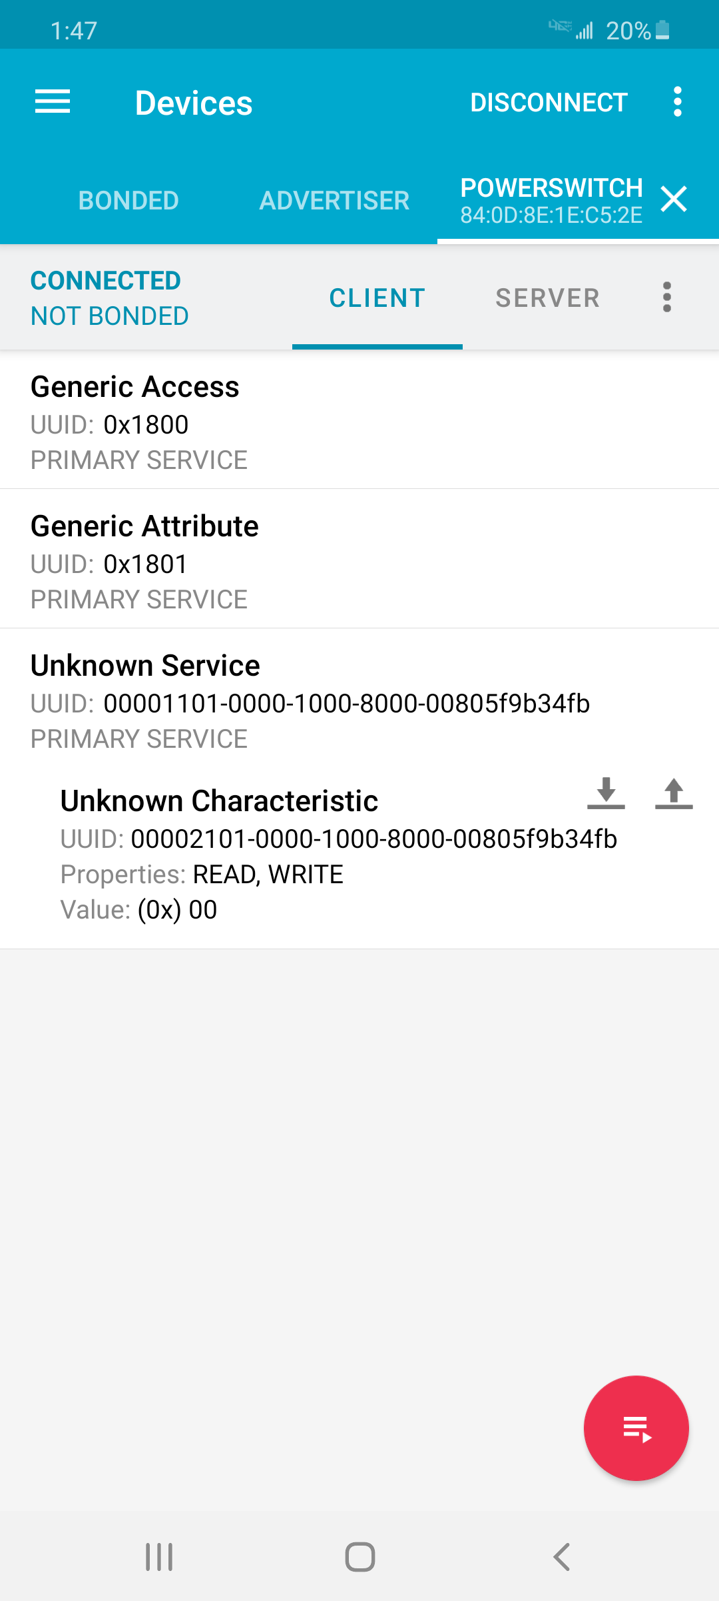
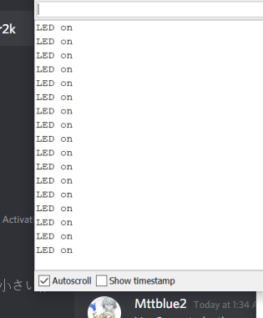
BLE Control
I am having problems here. Even though I can “Write” to my nano, it doesn’t save or actually change the value of the characteristic. So the LED stays on due to the default value is 0.
Hardcoding the value will stay and turn it on/off depending on what I use, but nothing from my phone changes it.

